Slide 1
Effects of Water Entrainment on Shock Propagation from a Nuclear Detonation
MAJ Trenton Freeman
Air Force Institute of Technology
30 January 2020

Slide 2
Overview
Background and Motivation
Problem
Thesis Objective
Limitations
Theory
Methodology
Results and Analysis
Conclusions
Future Work

Slide 3

Acknowledgments
Advisor: LtCol Michael Dexter
Committee Members:
Dr. John McClory
Maj James Bevins
Applied Research Associates
Second-Order Hydrodynamic Automatic Mesh Refinement Code (SHAMRC) developers
Research Sponsored by:

Slide 4
Background and Motivation
Limited Test Ban Treaty, 10 October 1963
Prevented U.S. ocean, atmospheric, and space nuclear tests
Reliance on Simulations for
Effects verification
Functionality
Threat assessment
Wartime and mission planning
Consequence management
Models can take days to develop and execute

Slide 5
Problem
How much energy is lost from a water surface nuclear detonation
Quantify through digital image processing of historic nuclear test films
Does Second-Order Hydrodynamic Automatic Mesh Refinement Code (SHAMRC) model energy lost?
Redwood Nuclear Test - June 1958 - Bikini Atoll, Pacific Proving Grounds
Notes:
Water entrainment
Energy transmission
Drag

Slide 6
Thesis Objective
Quantify energy lost in kilotons from a nuclear detonation over water
Compare results from films of the same detonation taken from different look angles
Compare results from multiple nuclear detonations
Determine if SHAMRC is accurately modeling shock wave propagation by comparing to film data

Slide 7
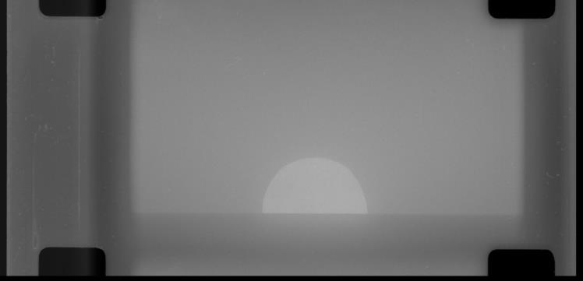
Limitations
Early Fireball Films
Out of focus causing blurry fireball images
Zoomed in too closely chopping off fireball in later frames
Not calibrated properly leading to light saturation (left)
Cloud Interference (right)
Aspen 319 kT
Tewa 5 MT
Notes:
Cameras have a neutral density filter (provides same attenuation at all wavelengths) allowing us to see the decrease in light intensity as shock front cools to tmin. Without the filter the camera would be saturated for the duration of the detonation

Slide 8
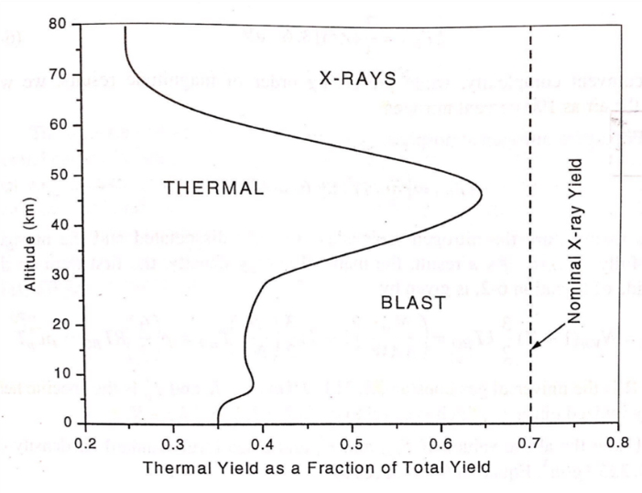
Theory – X-rays
Primary mechanism creating the shock wave
Primary x-rays created from fission fragment coulombic force interactions go on to ionize radiation case and weapon material.
Reradiated x-rays are emitted at lower energy from the ionized weapon case
Streaming x-rays fully ionize air creating
more x-rays as electrons undergo the
bremsstrahlung process
All x-rays produced are absorbed in
tens to hundreds of meters from detonation
Half of the x-ray energy is shared
between thermal and blast at sea level

Slide 9
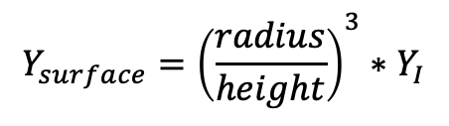
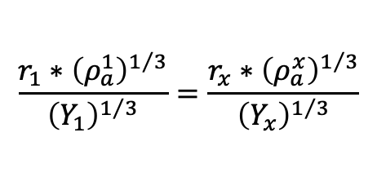
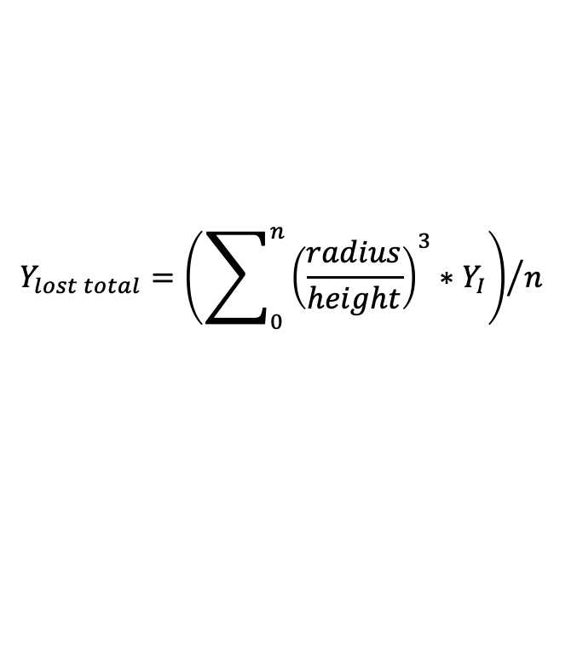
Theory - Cube Root Scaling
Compare height and radius of shock to determine apparent yield lost at the surface of the water
Equation 3 represents a cumulative yield lost with n different radii measurements
$$\frac{r_{1}∗{\left(ρ_{a}^{1}\right)}^{1/3}}{{\left(Y_{1}\right)}^{1/3}}=\frac{r_{x}∗{\left(ρ_{a}^{x}\right)}^{1/3}}{{\left(Y_{x}\right)}^{1/3}}$$
(1)
$$Y_{surface}={\left(\frac{radius}{height}\right)}^{3}∗Y_{I}$$
(2)
$$Y_{lost total}={\left(\sum_{0}^{n}{{\left(\frac{radius}{height}\right)}^{3}∗Y_{I}}\right)}/n$$
(3)

Slide 10
Methodology
MATLAB digital image processing
Determine height and radius
Apply cube root scaling
Determine apparent yield lost at the water surface
SHAMRC simulation
412 kT energy pill equivalent to test shot Redwood
Post process data
Plot radius and height from simulation with film data

Slide 11
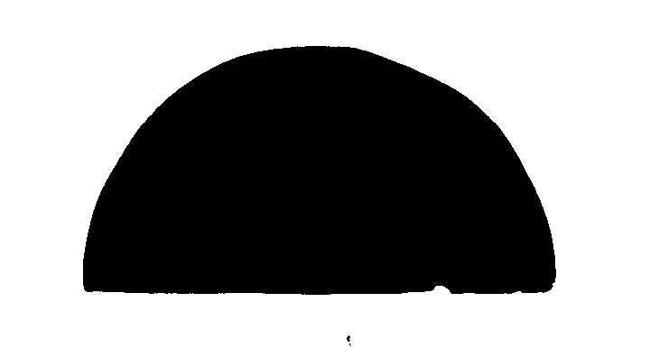
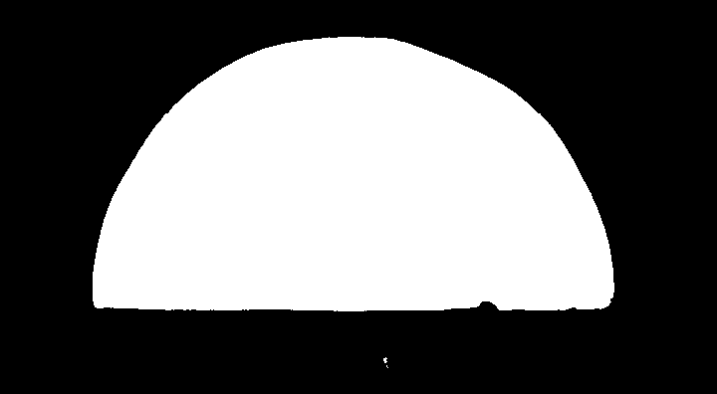
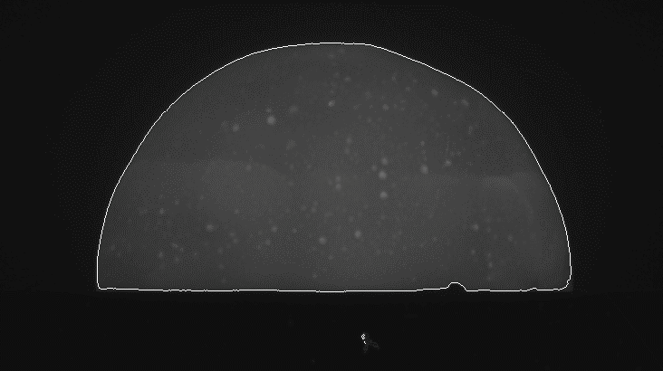
MATLAB Film Analysis

Slide 12
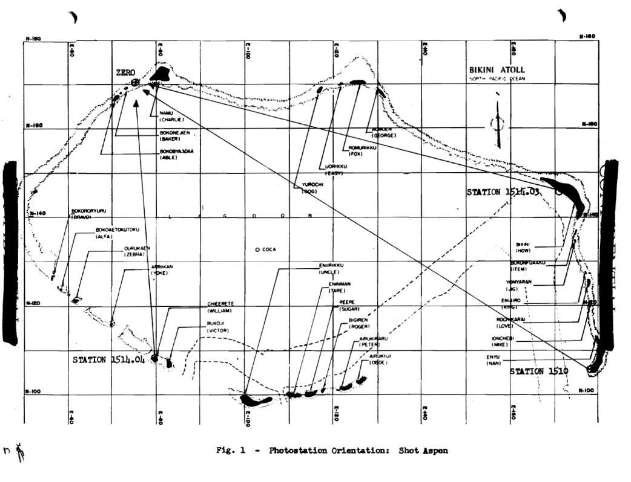
Test Shot Aspen 319 kT

Slide 13
Results and Analysis

Slide 14
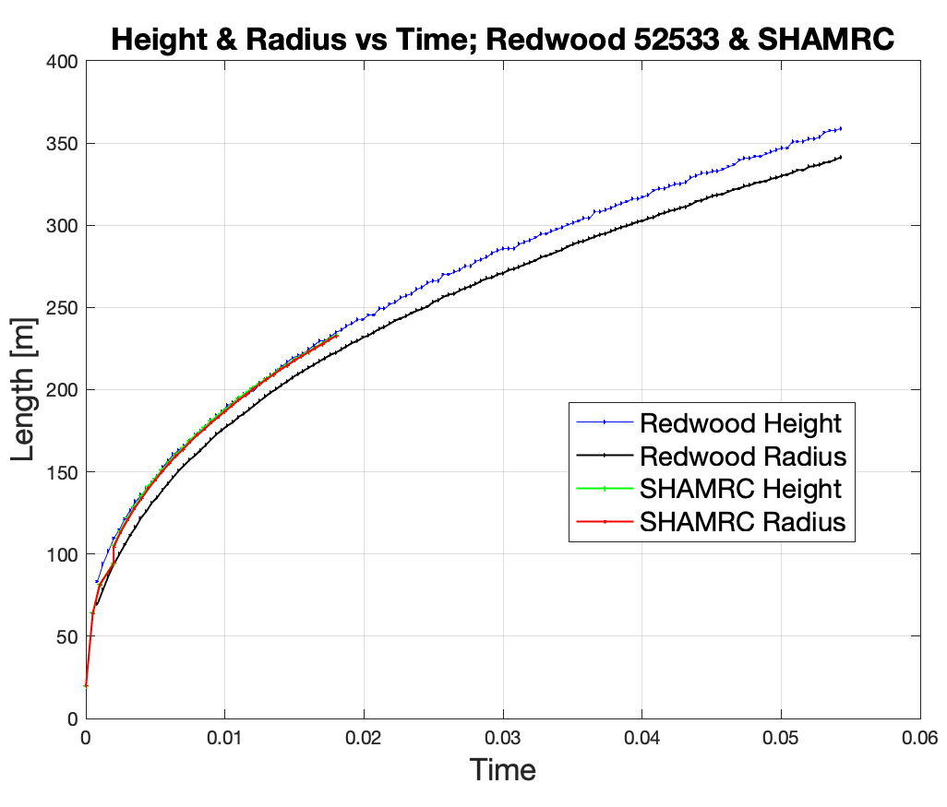
Height & Radius vs Time
SHAMRC began adding small quantities of energy early in the simulation
Total quantity remained under 1% until 18.0148 ms
18 % added from 18.0148 ms to 18.1079 ms
Simulation results to 18 ms used for analysis

Slide 15
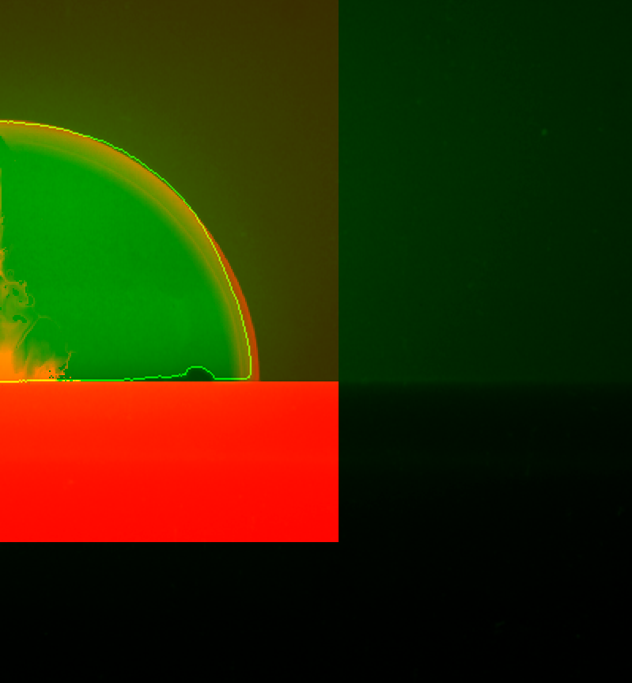
SHAMRC 18ms & Redwood Frame 45

Slide 16
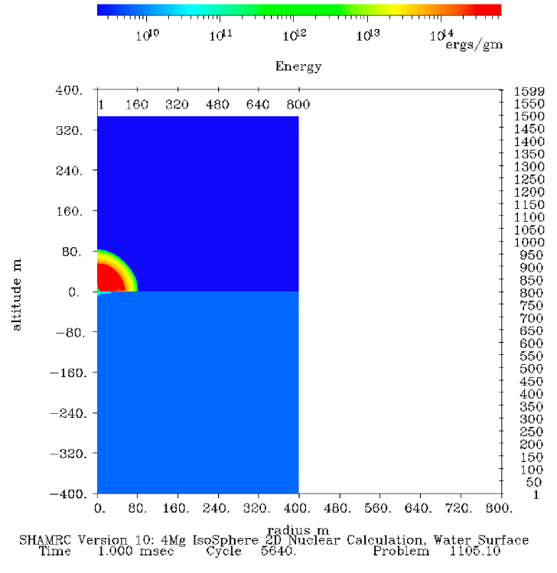
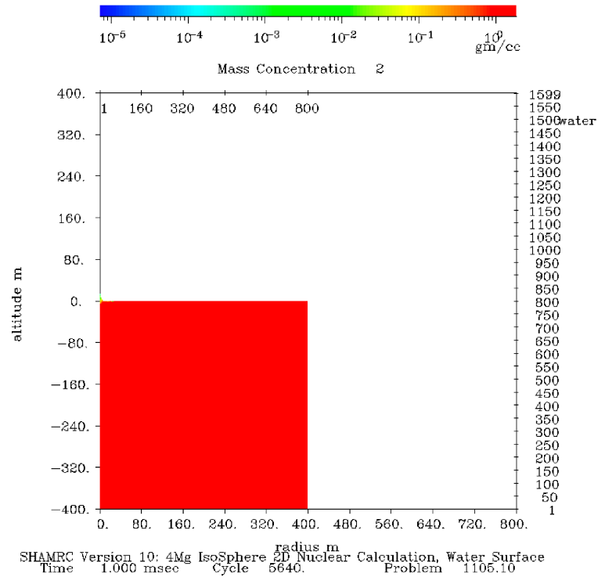
SHAMRC 412 kT 1.0 ms

Slide 17
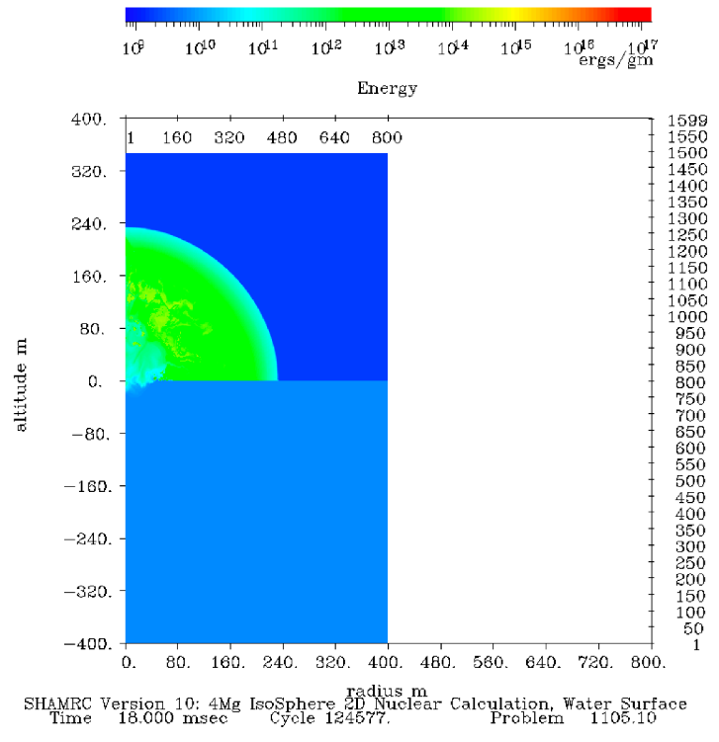
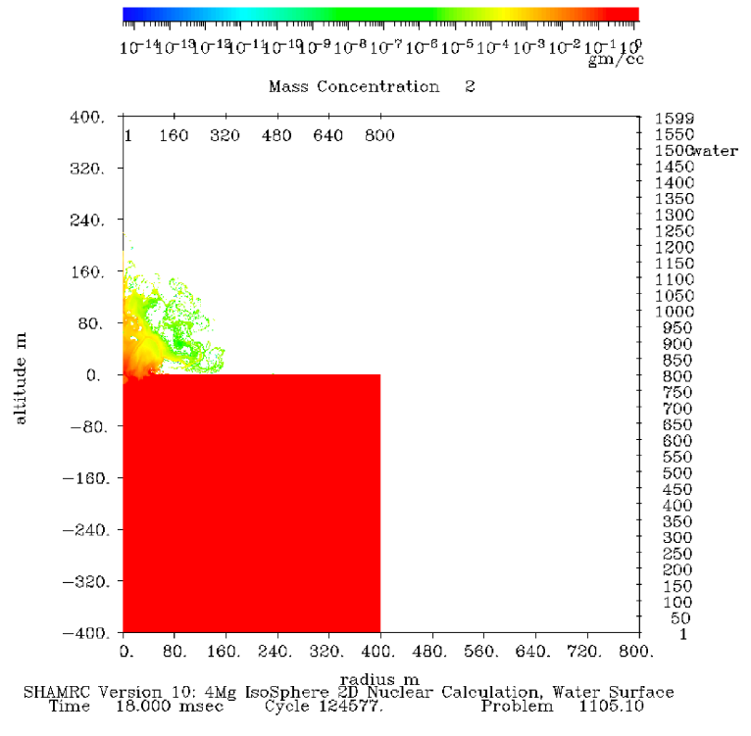
SHAMRC 412 kT 18.0 ms

Slide 18
Films
Test | Yield [kT] | Film Number | Station | Distance to GZ [m]
Redwood | 412 | 52533 | 1514.03 | 15216.39
Fir | 1360 | 50992 | 1510 | 37166.14
Fir | 1360 | 50999 | 1514.04 | 18924.38
Aspen | 319 | 52328 | 1510 | 37200.06
Aspen | 319 | 52334 | 1514.04 | 18937.60
Aspen | 319 | 52343 | 1514.03 | 29888.98
Maple | 213 | 52184 | 1514.03 | 15210.10
Maple | 213 | 52185 | 1514.03 | 15207.95
Maple | 213 | 52191 | 1514.04 | 23493.22

Slide 19
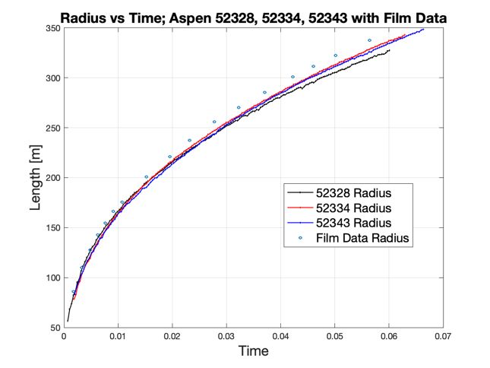
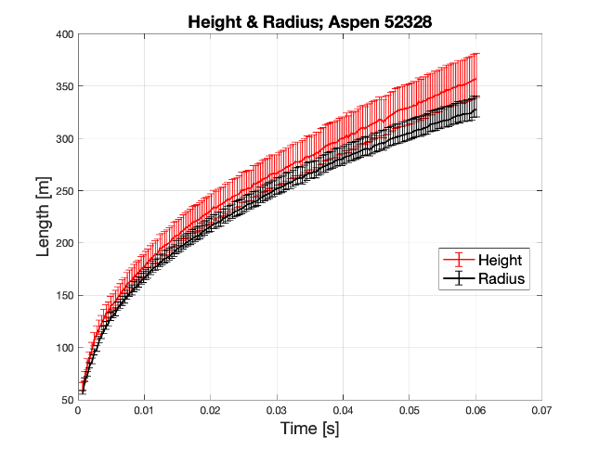
Aspen 319 kT
Error Bars
2 percent film shrinkage in the upper bound error bar only
Quantification of error in sensitivity parameter of image processing code

Slide 20
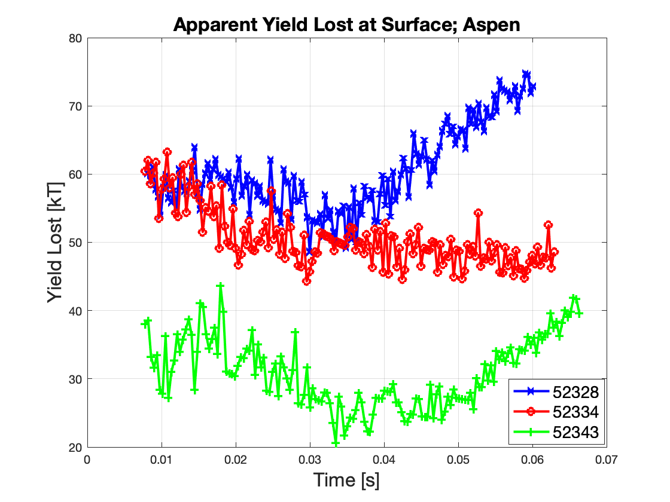
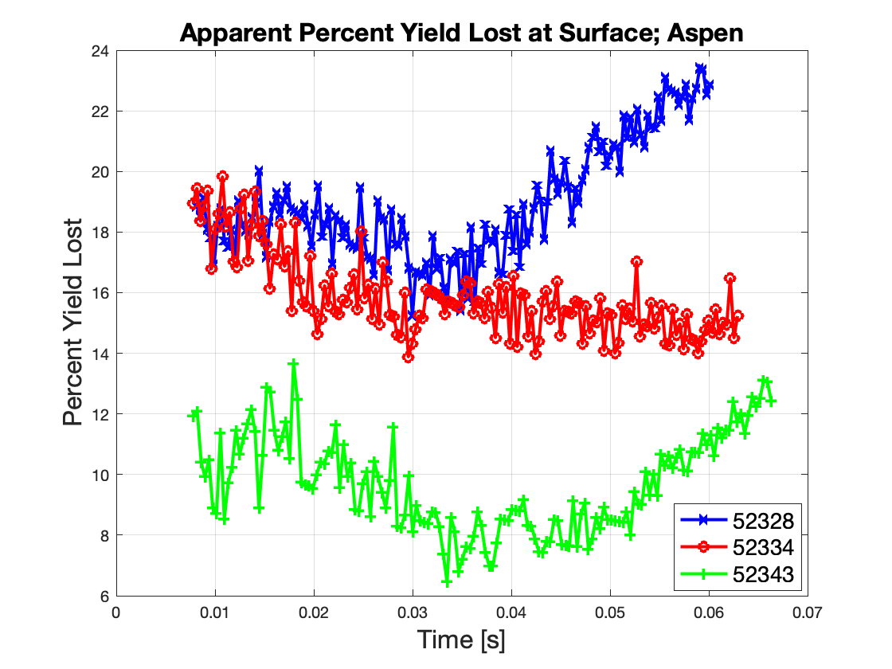
Aspen 319 kT

Slide 21
Conclusions
Apparent yield lost from 9 films examined ranged from 10 to 22 percent
Distinct difference in height and radius in all images during the times of interest
Weapons effects are dampened along the surface of water due to water entrainment, energy transmission and drag effects
Evaluate impacts to nuclear targeting, threat assessments, and consequence management

Slide 22
Future Work
Leverage simulations from other high-fidelity multi-physics codes such as ALE3D and MIRANDA
Analyze additional films for more data points to draw more concrete conclusions
Compare detonations over water to detonations over land
Conduct shock tube experiments to determine if the loss terms of water entrainment, energy transmission into the water, and drag effects can be decoupled

Slide 23
Questions

Slide 24
Backup Slides

Slide 25
Limitations
Shock front identification as detonation approaches t_{min}
Shock wave becomes increasingly opaque as it cools preventing the transmission of light from the diffusively growing inner fireball
Neutral density filter restricts too much light from reaching camera lens
SHAMRC
Export controlled – requires Defense Supercomputing Recourse Center’s (DSRC) high performance computing (HPC) environment
Computationally expensive
Hierarchy the code itself

Slide 26
Prompt Energy
2 Types of Fission Energy
Prompt and Delayed
Prompt Fission Energy
Fission fragment kinetic energy – comprises 93% of prompt energy and 70% of total weapon yield
Neutron kinetic energy
Gamma ray energy
Prompt Fission Energy
Energy Form | U²³⁵ Energy (MeV) | Pu²³⁹ Energy (MeV)
Fission Fragment Kinetic Energy | 168 | 172
Neutron Kinetic Energy | 5 | 6
Prompt Gamma Energy | 7 | 7
Total Prompt Energy | 180 | 185

Slide 27
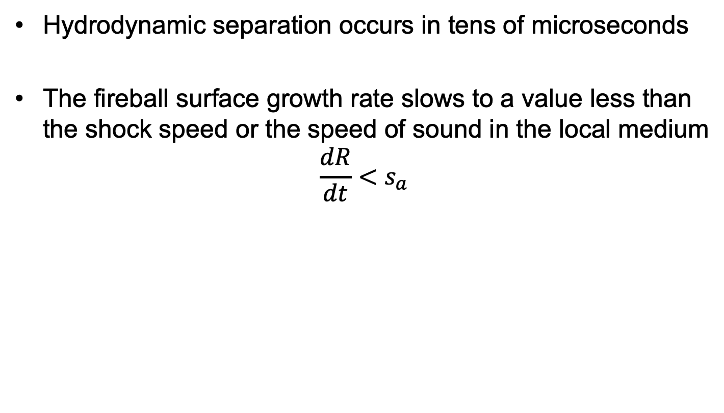
Hydrodynamic Separation
Hydrodynamic separation occurs in tens of microseconds
The fireball surface growth rate slows to a value less than the shock speed or the speed of sound in the local medium
$$\frac{dR}{dt}<s_{a}$$

Slide 28
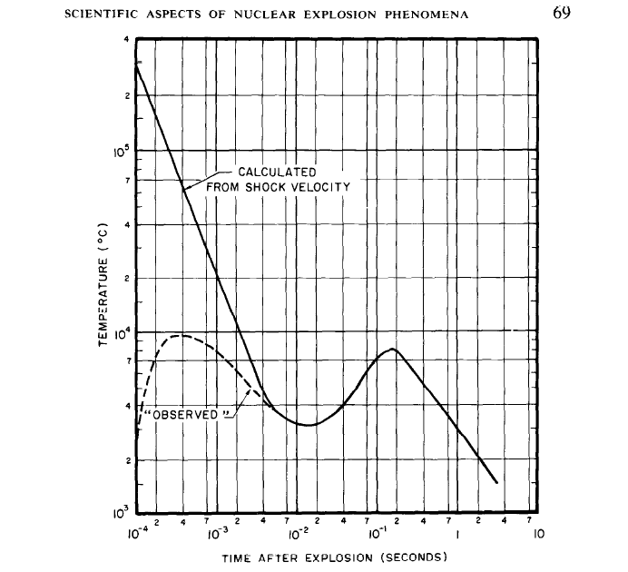
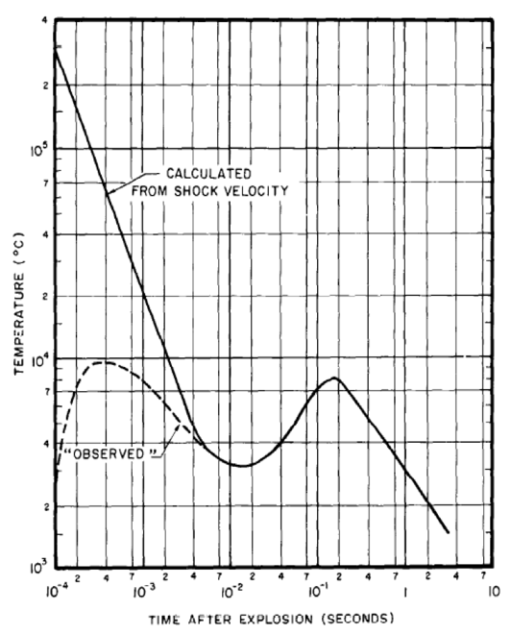
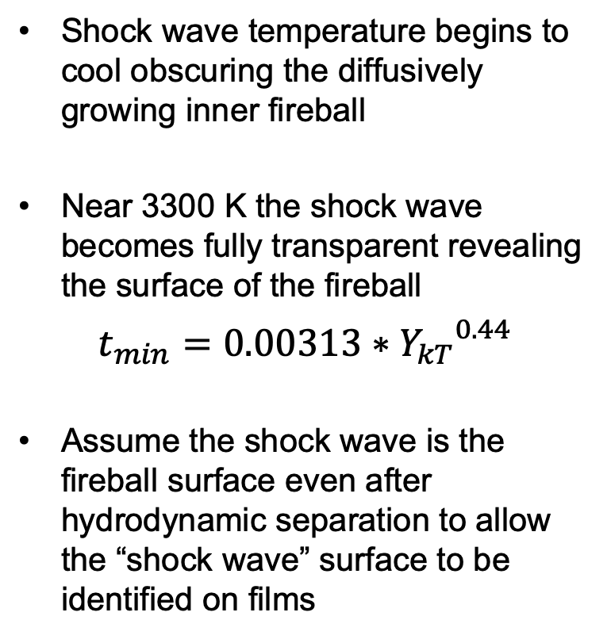
Thermal Minimum
Shock wave temperature begins to cool obscuring the diffusively growing inner fireball
Near 3300 K the shock wave becomes fully transparent revealing the surface of the fireball
$t_{min}=0.00313∗{Y_{kT}}^{0.44}$
Assume the shock wave is the fireball surface even after hydrodynamic separation to allow the “shock wave” surface to be identified on films
Second
Thermal Maximum
~8000C
Observed
Breakaway
~3000C
Hydrodynamic
Separation
Notes:
Cameras have a neutral density filter (provides same attenuation at all wavelengths) allowing us to see the decrease in light intensity as shock front cools to tmin. Without the filter the camera would be saturated for the duration of the detonation

Slide 29
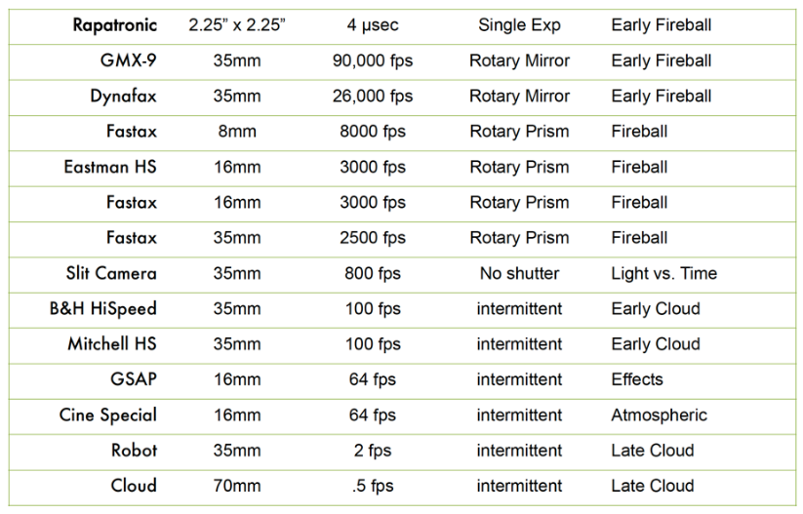
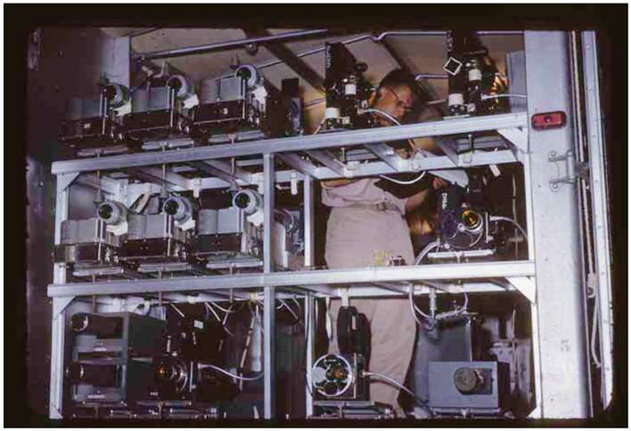
Camera Types

Slide 30
Film Selection
Camera issues
Out of focus causing blurry fireball images
Zoomed in too closely chopping off fireball in later frames
Not calibrated properly leading to light saturation (left)
Cloud Interference (right)
Aspen 319 kT
Tewa 5 MT

Slide 31
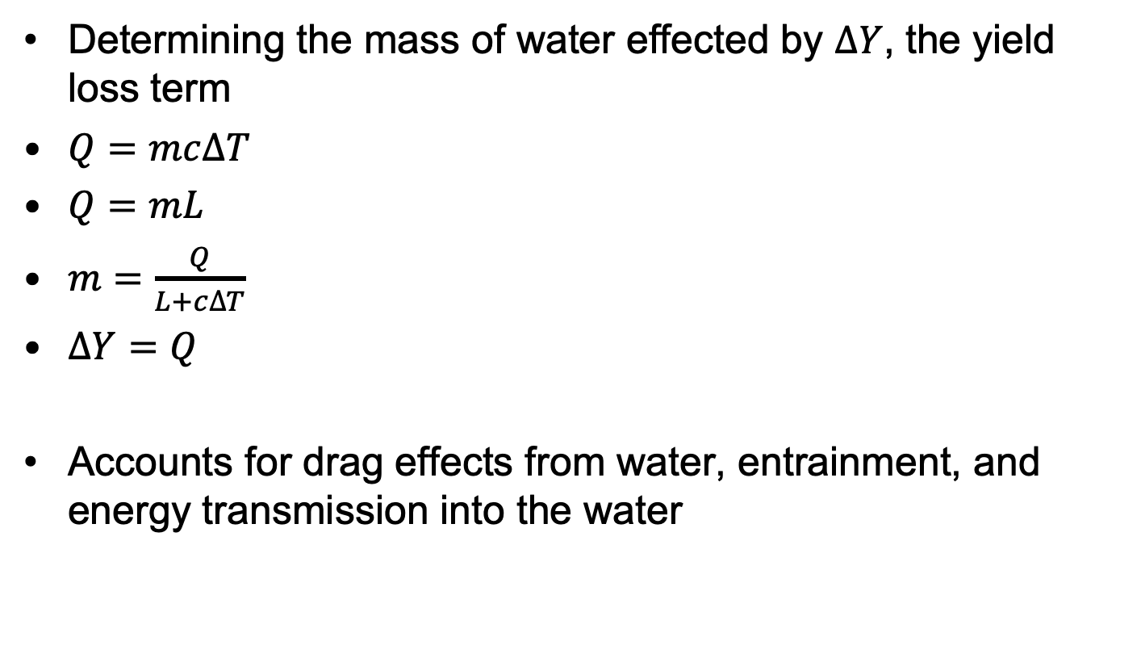
Mass of Water Vaporized
Determining the mass of water effected by $ΔY$, the yield loss term
$Q=mc∆T$
$Q=mL$
$m=\frac{Q}{L+c∆T}$
$ΔY=Q$
Accounts for drag effects from water, entrainment, and energy transmission into the water
Notes:
Q is the heat energy transferred
c is the specific heat 4,186 J/kg*C
L is Latent Heat
No way to decouple effects through these simulations

Slide 32
Barge Shots
35 Shots Total
13 Shots Y > 1 Mt
2 Shots Y < 10 kt
6 ft < HOB < 15 ft
Available
Analyzed
Notes:
Redwood – Film No. 52533
2500 fps
Frames 93 to 210 = 117 frames

Slide 33
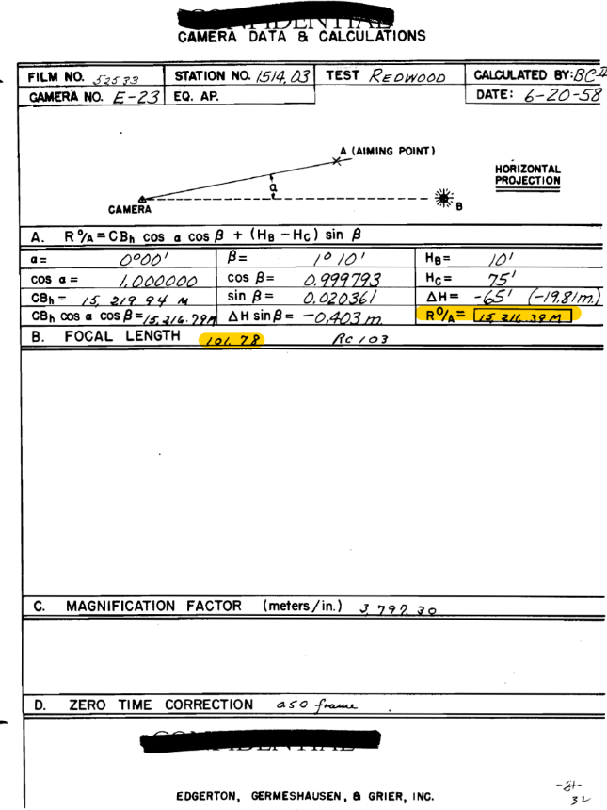
Redwood Film Data Sheet

Slide 34
Redwood
Yield = 412kT
Film Number 52533

Slide 35
Redwood
Yield = 412kT
Film Number 52534

Slide 36
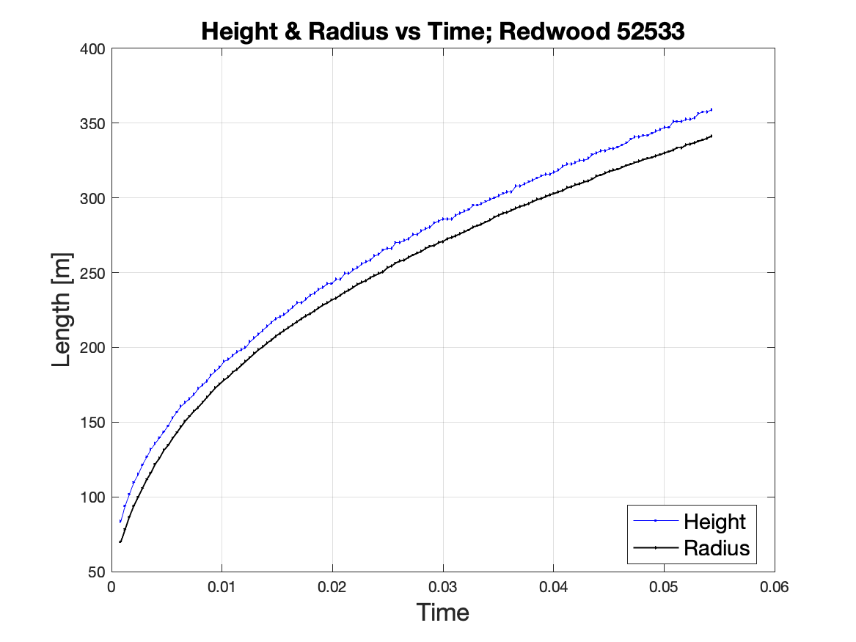
Height & Radius vs Time

Slide 37
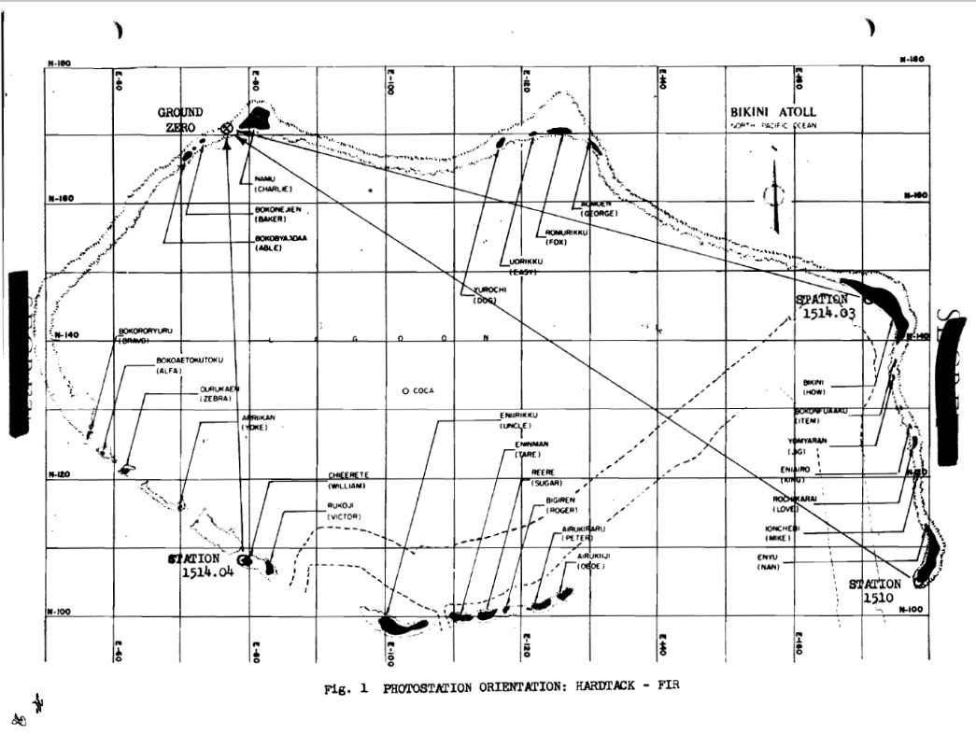
Test Shot Fir 1.36 MT

Slide 38
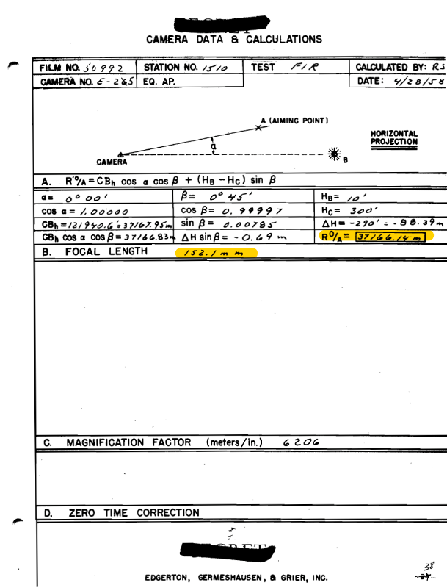
Fir 50992

Slide 39
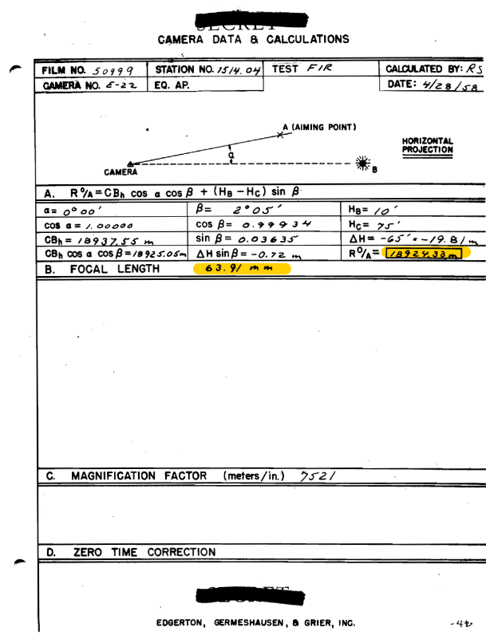
Fir 50999

Slide 40
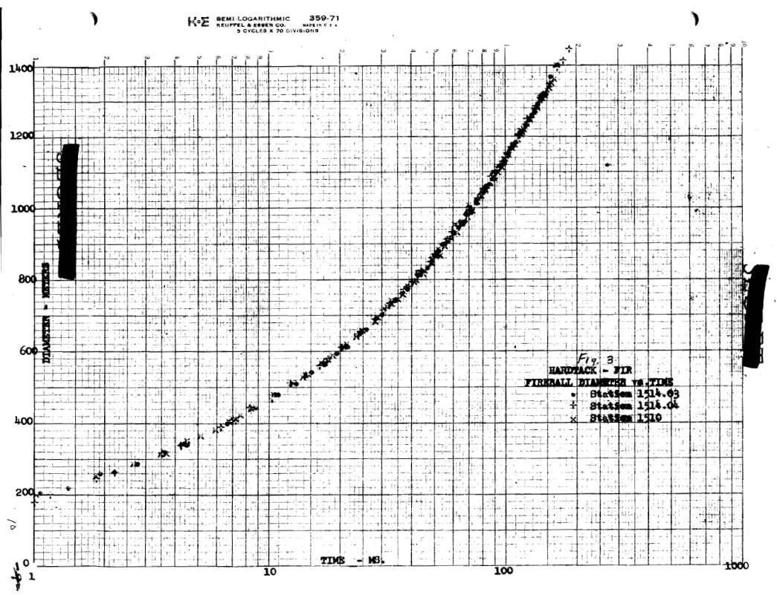
Data Sheet Diameter vs Time

Slide 41
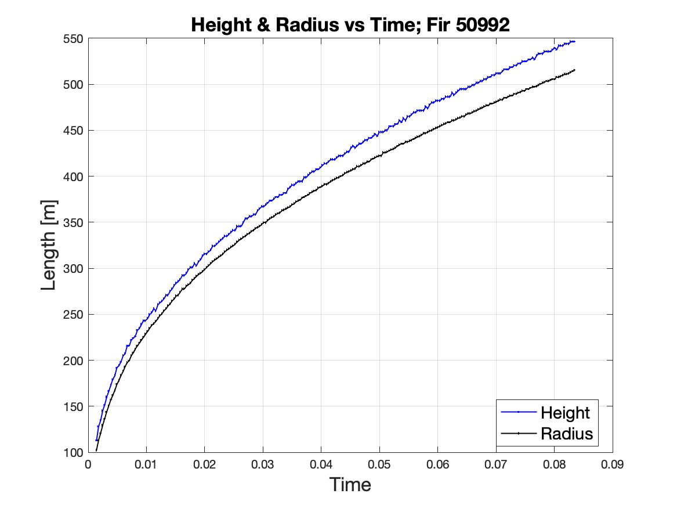
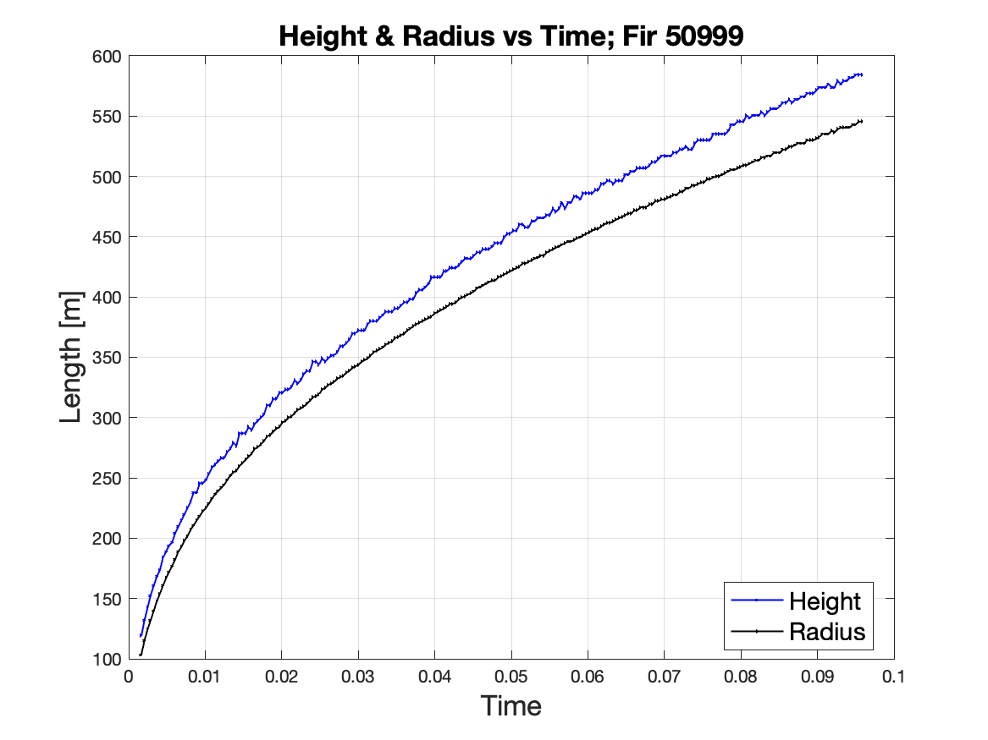
Height & Radius vs Time
Test Shot Fir: 1.36 MT,

Slide 42
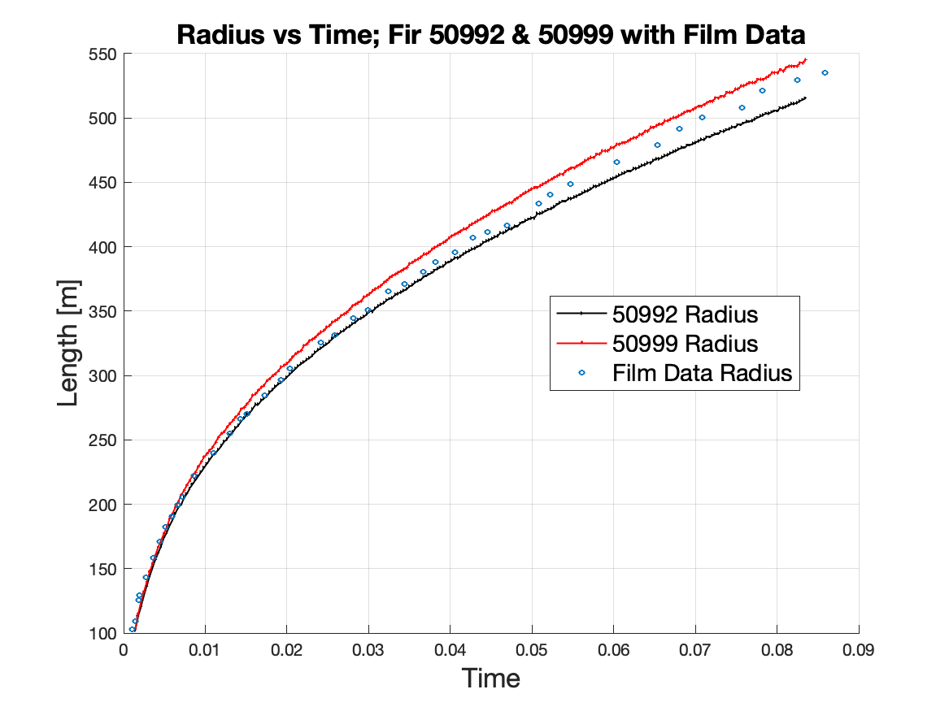
Radius vs Time

Slide 43
Uncertainty Analysis
Additional 2.5% on upper bound error bar only to compensate for 2.5% film shrinkage as quantified by LLNL

Slide 44
Uncertainty Analysis

Slide 45
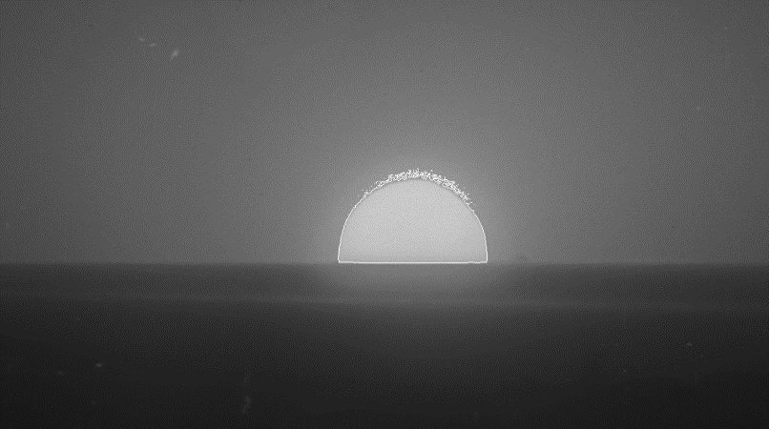
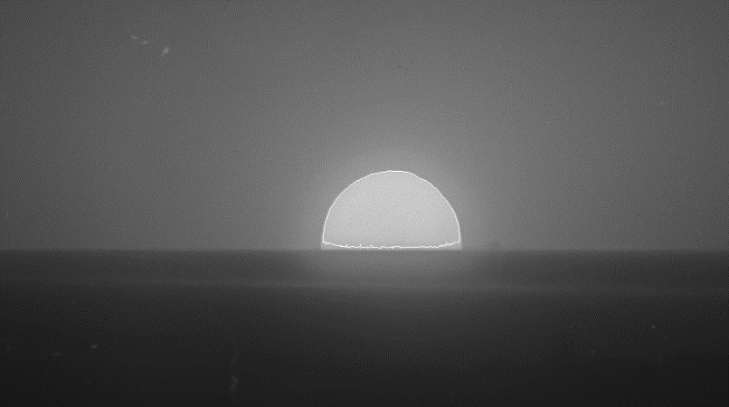

Redwood Sensitivity Analysis Frame 20

Slide 46
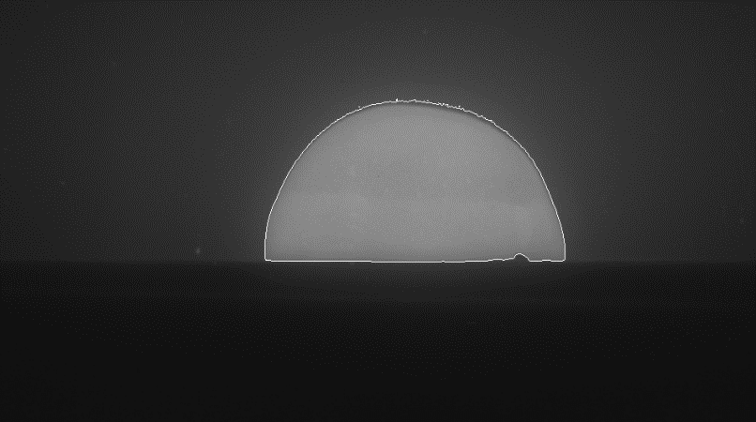


Redwood Sensitivity Analysis Frame 70

Slide 47
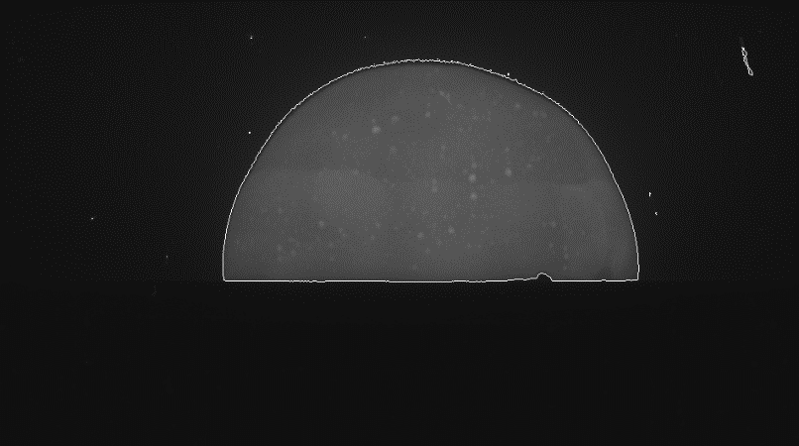
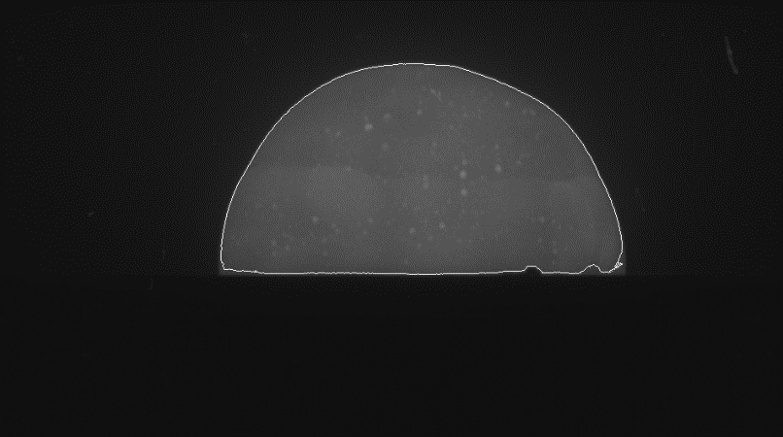

Redwood Sensitivity Analysis Frame 130

Slide 48
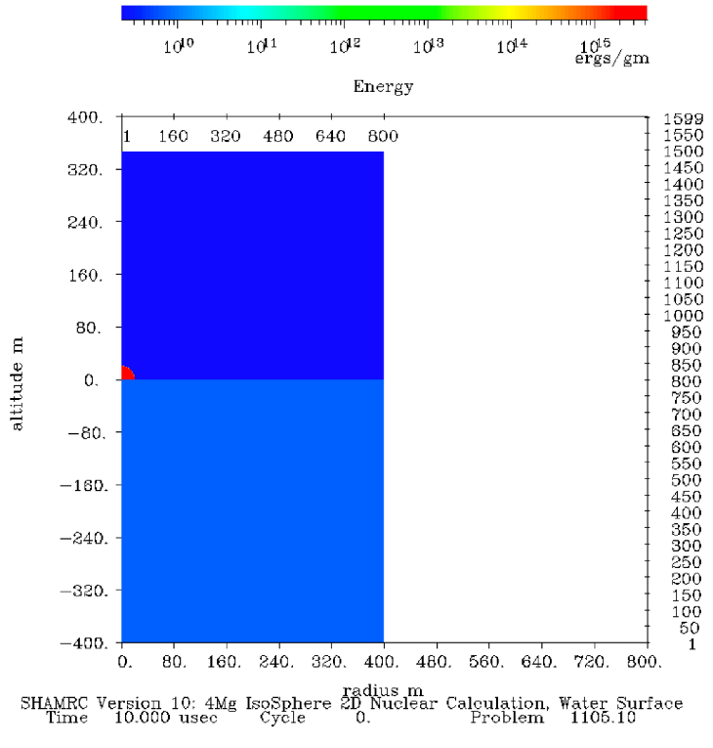
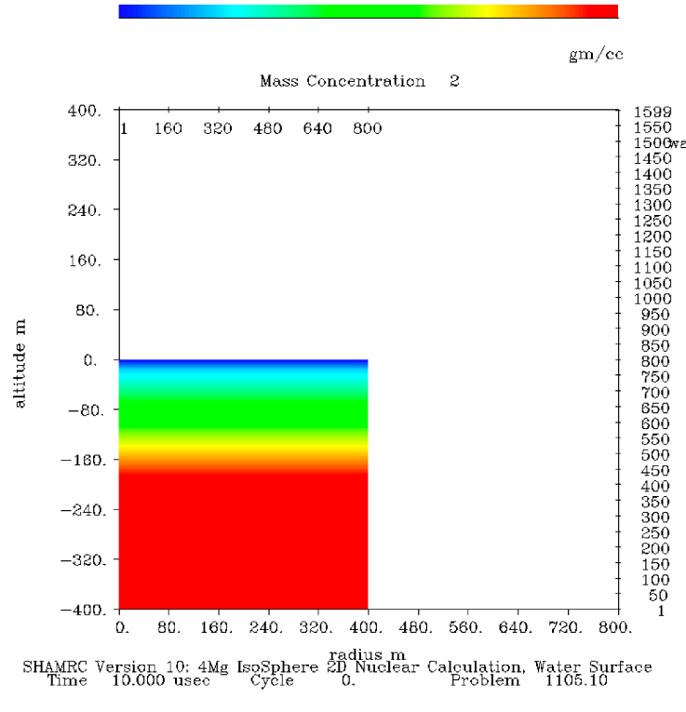
SHAMRC 412kT

Slide 49
1.0 ms

Slide 50
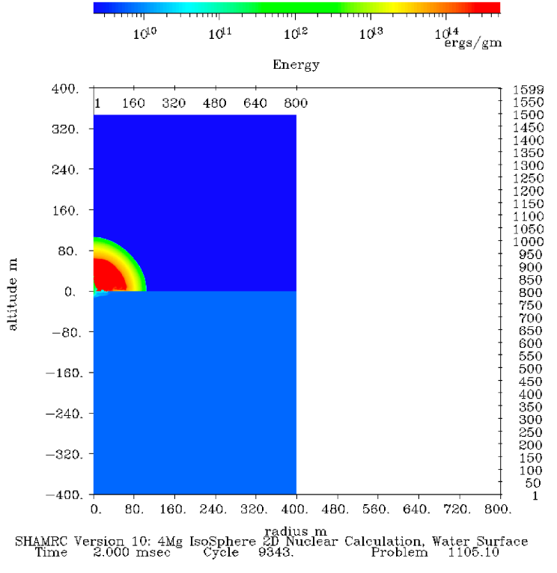
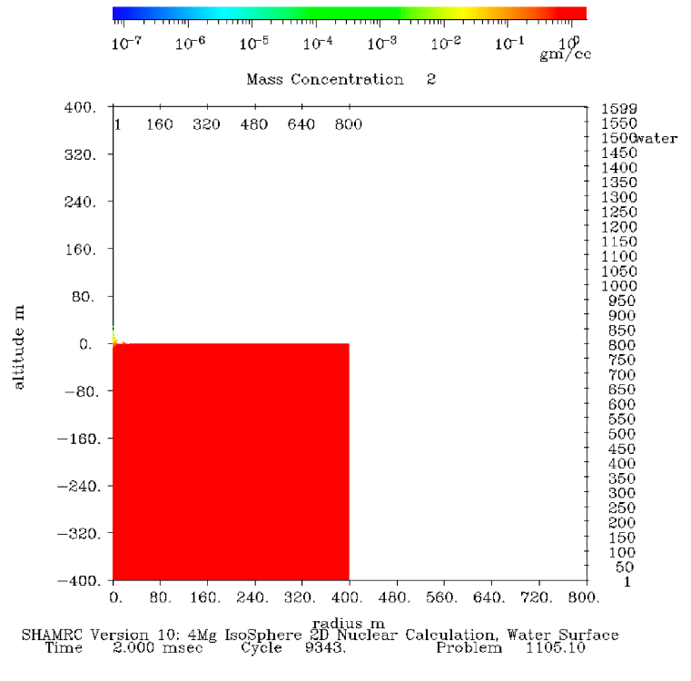
2.0 ms

Slide 51
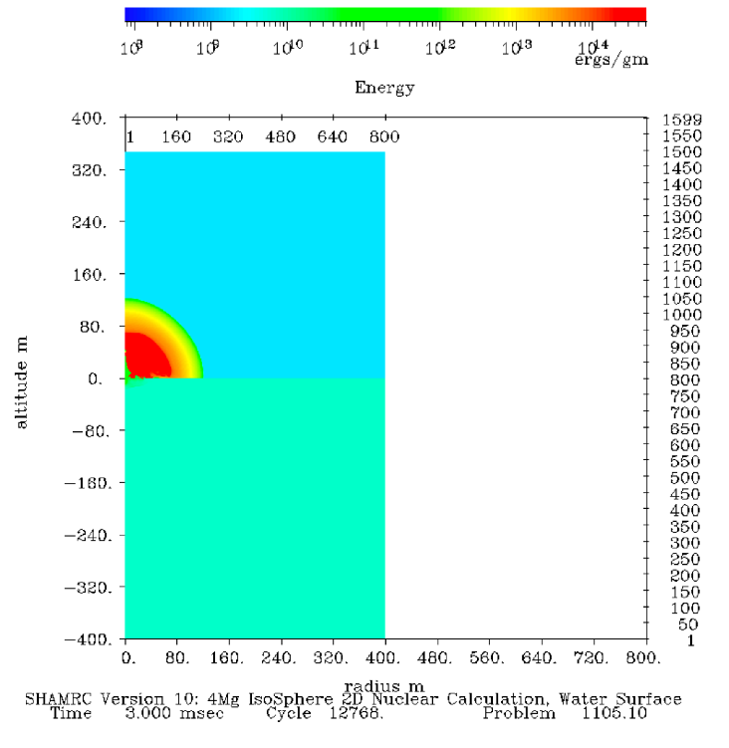
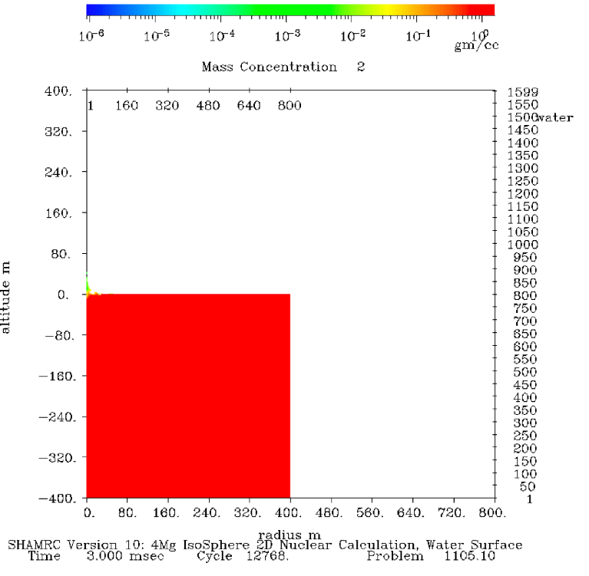
3.0 ms

Slide 52
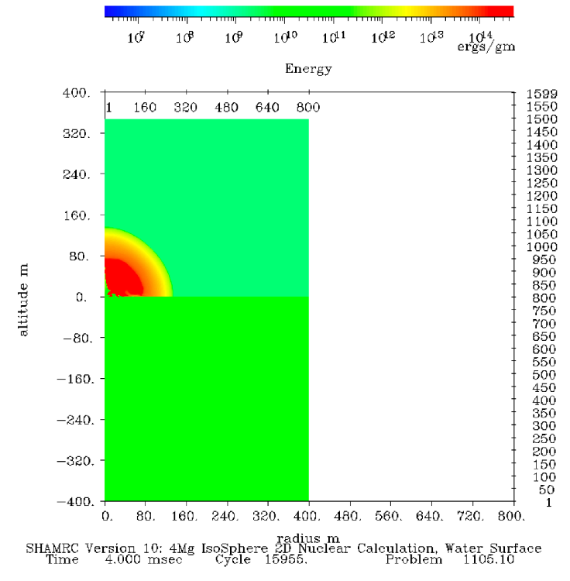

4.0 ms

Slide 53
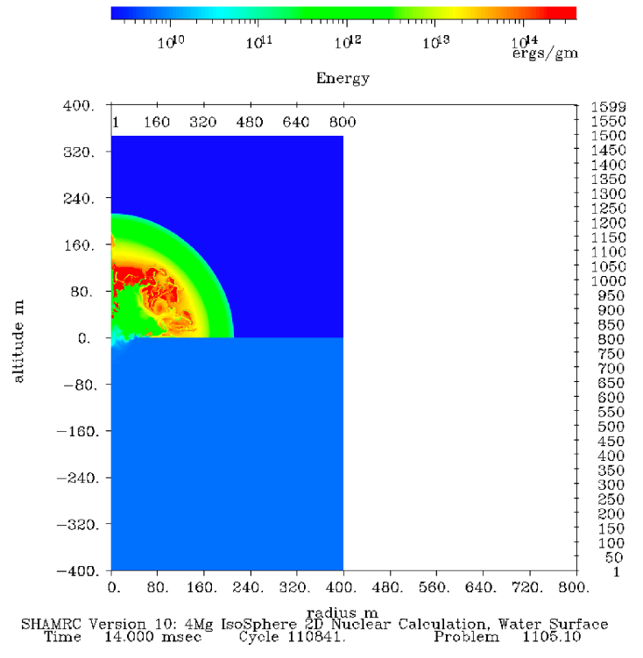
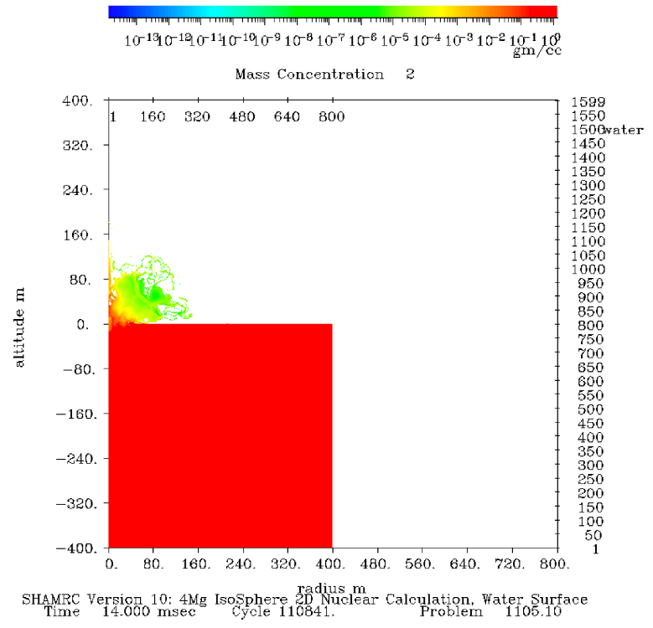
14.0 ms

Slide 54
18.0 ms

Slide 55
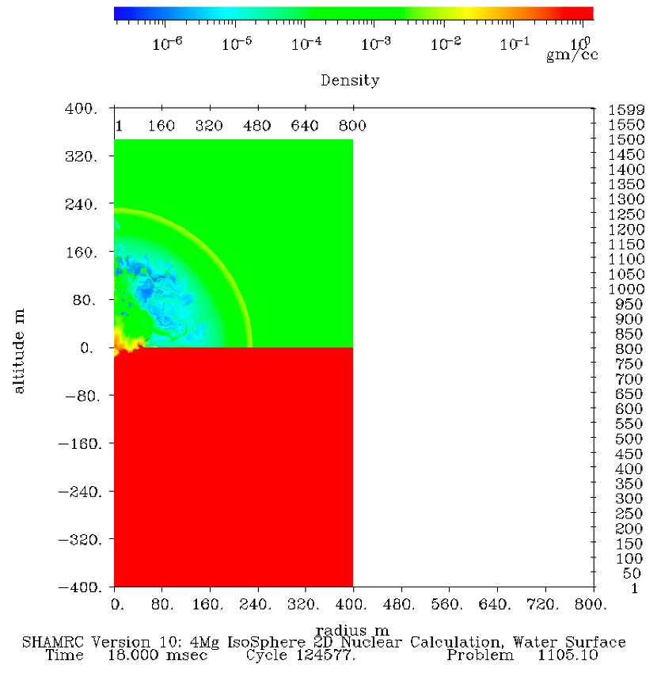
18.0 ms

